Slide 1

WHAT ARE THE CHANCES OF SURVIVING THE
TITANIC?
By Dara Adesina, Mari Zena & Maruti Biswas

Slide 2
— Introduction —
This project aims to build a machine learning model that predicts the likelihood of survival for passengers aboard the Titanic based on various attributes such as age, gender,ticket class, and port of embarkation.

Slide 3
— Project Overview —
1.
Training Set (train.csv)
3.
gender_submission.csv
2.
Testing Set (test.csv)
Provides the ground truth for each passenger, used to build the machine learning model
An example submission file, assuming only females survived
Does not have the ground truth, used to test the model

Slide 4
— Passenger Class Survival Percentages —
Third Class
Lower
24%
Second class
Middle
47%
First Class
Upper
63%

Slide 5
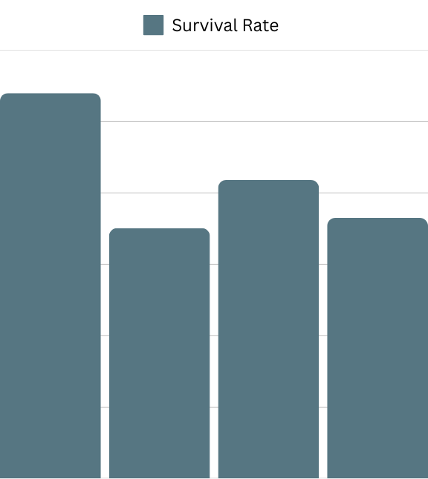
— Age Group —
1.
2.
3.
The age group with the highest survival rate at 54% is ages 0-17.
0.6
The age group with the second highest survival rate at 42% is ages 30-49.
0.5
0.4
The age groups with the lowest survival rates are 50+ at 36%, with age group 18-29 being the absolute lowest at about 35%.
0.3
0.2
0.1
0.0
0-17 18-29 30-49 50+

Slide 6
— Embarkation Port —
Southampton
Lowest survival rate at 34%.
Cherbourg
Highest survival rate at 55%.
Queenstown
Survival rate of 39%

Slide 7

— Gender —
1.
2.
Women have a 74% chance of survival, whereas men have about a 19% chance of survival.
0.8
0.6
0.4
0.2
0.0
Female
Male

Slide 8
In Conclusion…
The model predicts that 38.04% of passengers survive the Titanic.

Slide 9
Thanks!
Do you have any questions?
Please keep this slide for attribution.

